Slide 2

Marketing Campaign Prediction
- Kiran R Patil

Slide 3
Source:
Kaggle
Problem statement:
Aditya Marketing is facing low response rates to their marketing campaigns. The objective of this project is to conduct thorough Exploratory Data Analysis, extracting insights through univariate and bivariate analysis. And Recommended strategic customer targeting tactics.
To predict customer response to an offer for a specific product or service, enabling targeted marketing strategies and optimizing campaign effectiveness.

Slide 4
Problems the company might be facing:
Low Response Rates
Inefficient Marketing Spending
Lack of Targeted Marketing
Unoptimized Campaigns
Resource Constraints
Competing with Competitors

Slide 5
How will my model help? by Analytics-enabled Marketing Strategy
Low Response Rates
Inefficient Marketing Spending
Lack of Targeted Marketing
Unoptimized Campaigns
Resource Constraints
Competing with Competitors
→ Improve Response Rates
→ Optimize Marketing Spending
→ Enable Targeted Marketing
→ Optimize Campaigns
→ Overcome Resource Constraints
→ Stay Competitive

Slide 6
1. Reading data documentation
Target

Slide 7
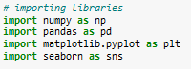
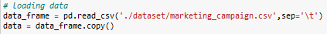
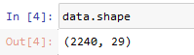
2. Loading libraries and data

Slide 8
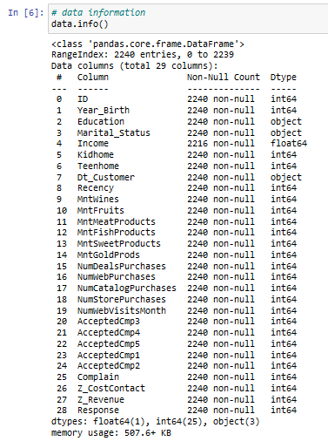
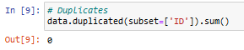
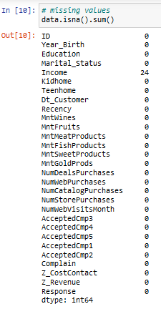
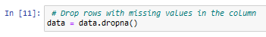
3. Exploratory Data Analysis
It is a crucial step in the data analysis process. The main goal of EDA is to gain a better understanding of the data before building predictive models.
3.1 Univariate data analysis

Slide 9
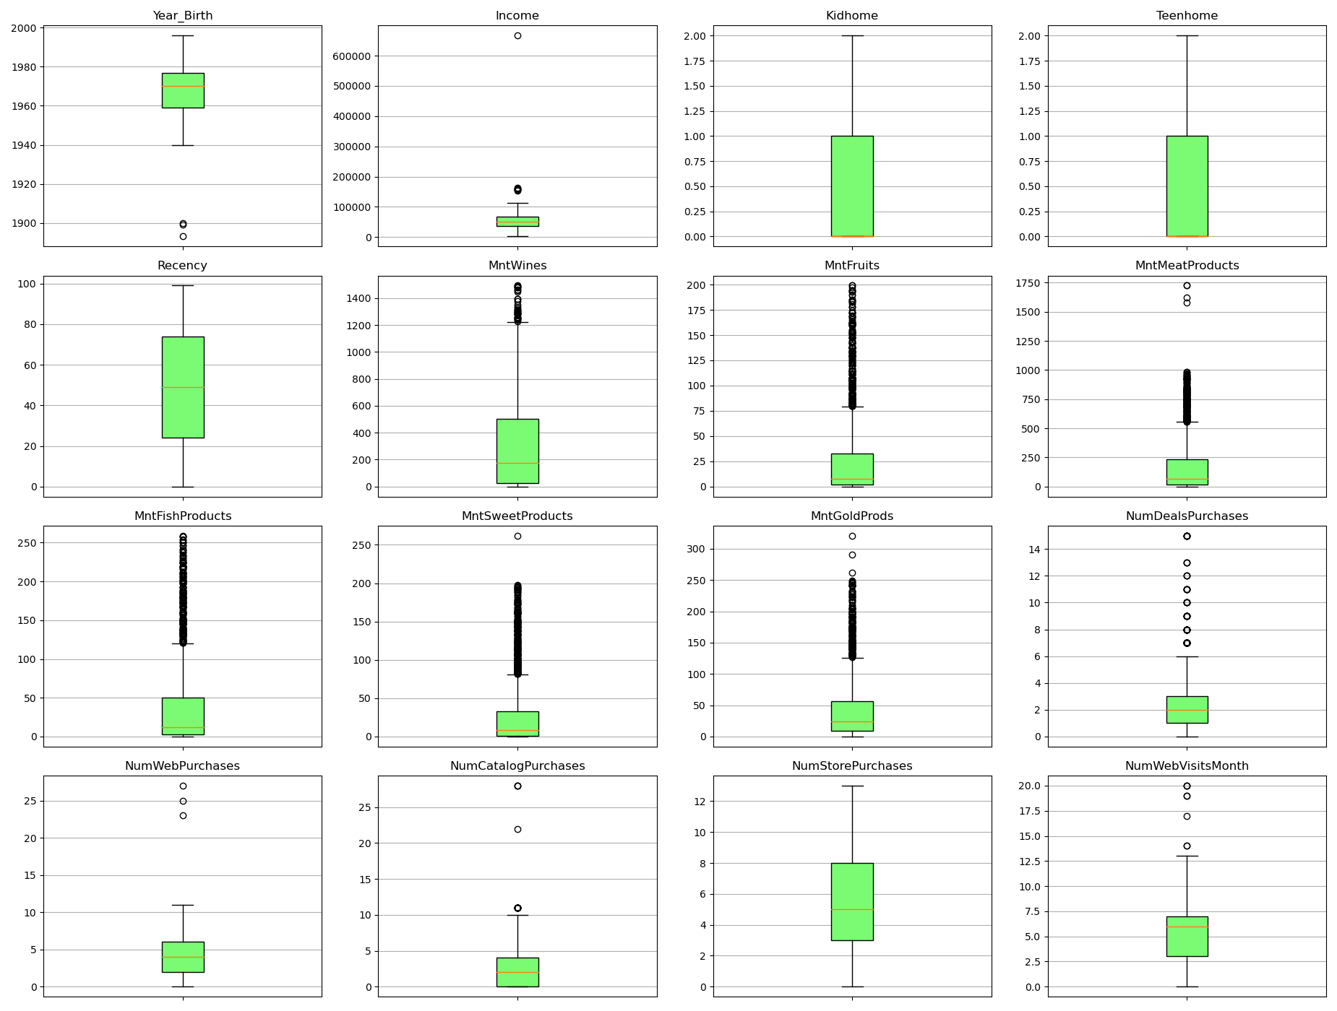
3.1.1 Numeric data
boxplot

Slide 10
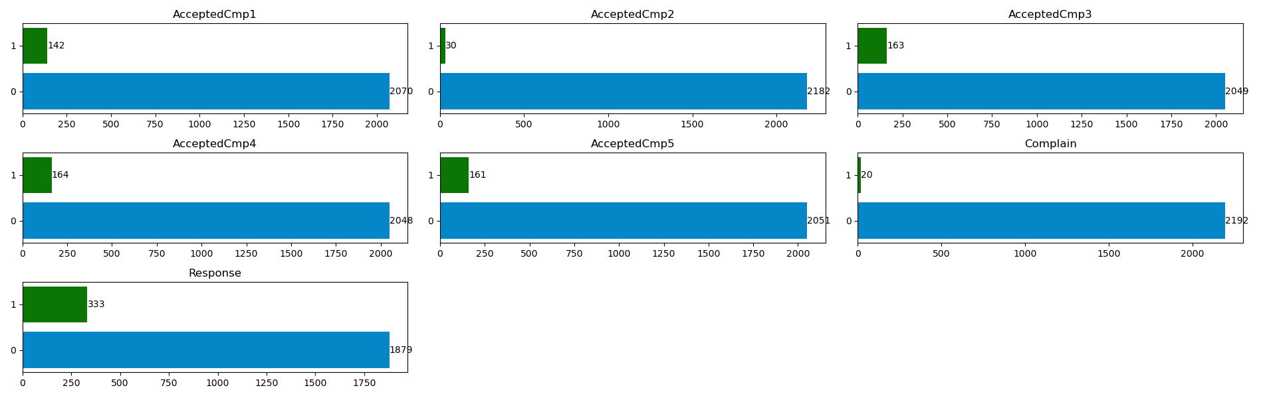
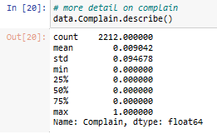
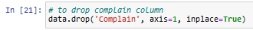
3.1.2 Categorical data
Horizontal Bar plots
AcceptedCmp1,2,3, 4 and 5: values are unbalanced, with many more 0s than 1s.
AcceptedCmp2 also seems suspiciously more unbalanced than the others.
Complain: highly unbalanced.
Response: not highly unbalanced.

Slide 11
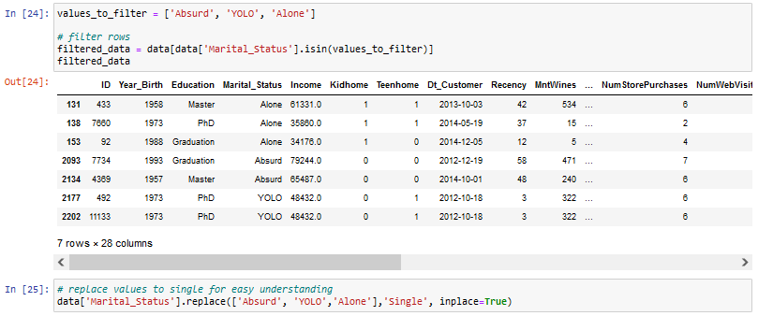
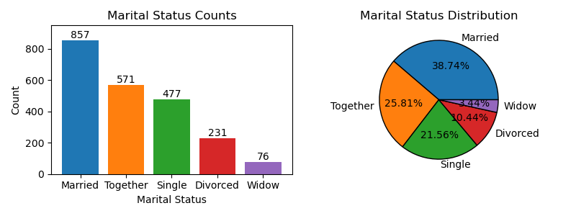
# Marital Status

Slide 12
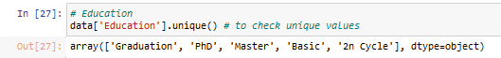
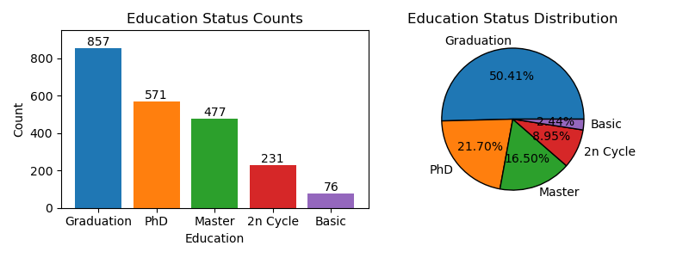
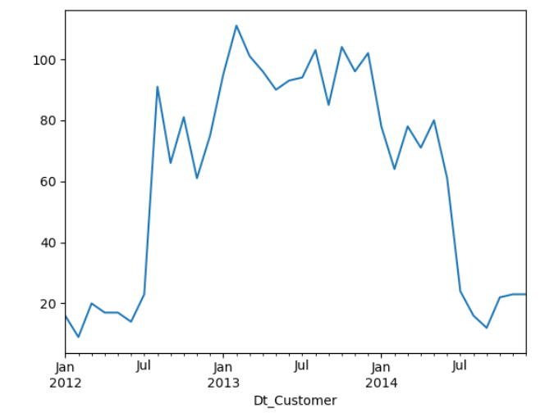
# Education
we have many people with PhDs in our sample, which does not seem to fit what we see in real life.
This might mean that our sample is biased or that people lied in the survey.
3.1.3 Date
Most customers in the database seem to have been registered between July 2012 and May 2014. What happened in the 6 months before and after that, where we have some customers, but not many?

Slide 13
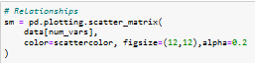
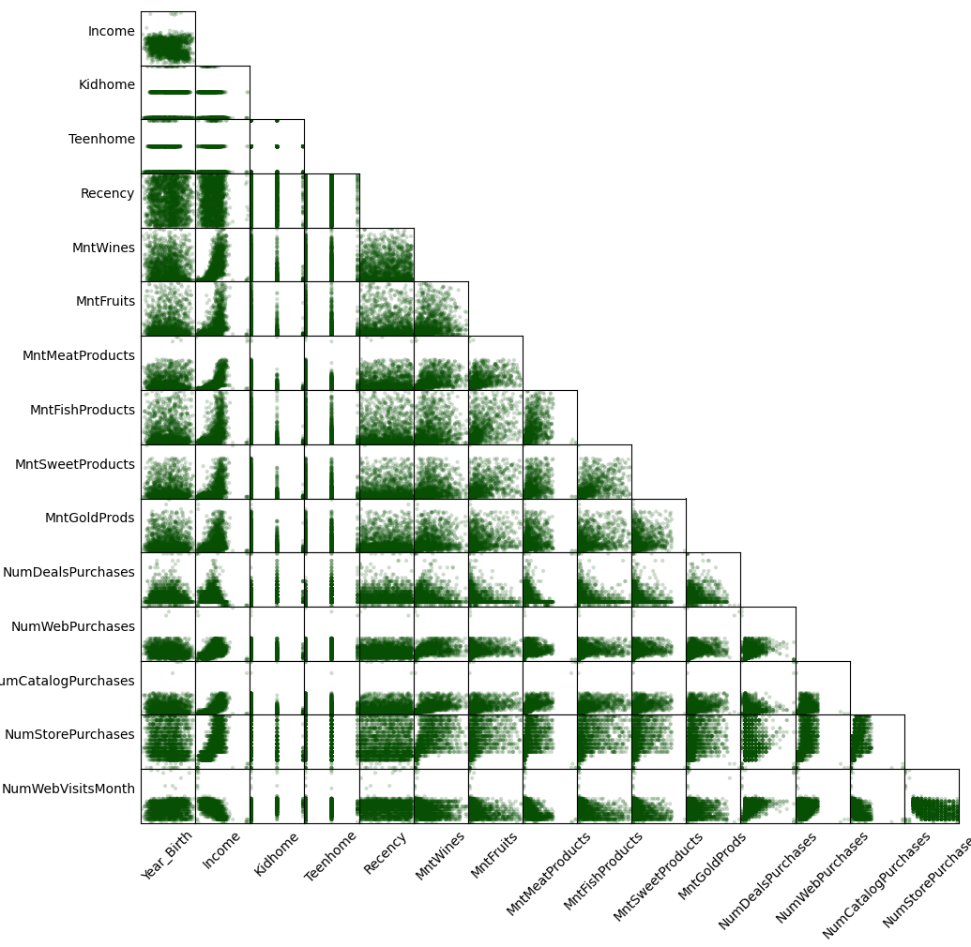
3.2 Bivariate data analysis
scatter_matrix
Same for NumWebPurchases and NumWebVisitsMonth, even though we had not spotted those outliers from the boxplot (they didn’t seem that discrepant)
It is hard to spot any relationships with Income and Year_Birth because the outliers make their plots look compressed.

Slide 14
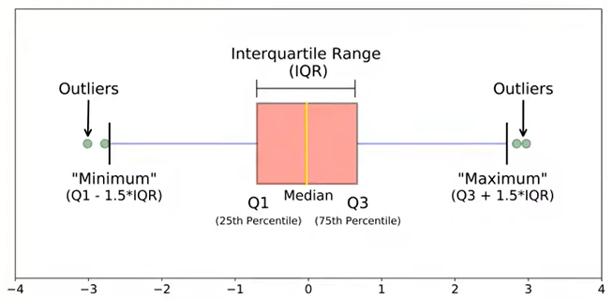
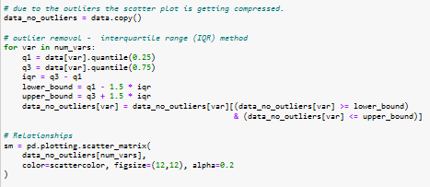
outlier removal - interquartile range (IQR) method
It is defined as the difference between the third quartile (Q3) and the first quartile (Q1) of the data.
The IQR represents the middle 50% of the data and is robust to outliers, making it a useful when dealing with skewed or non-normally distributed data.

Slide 15
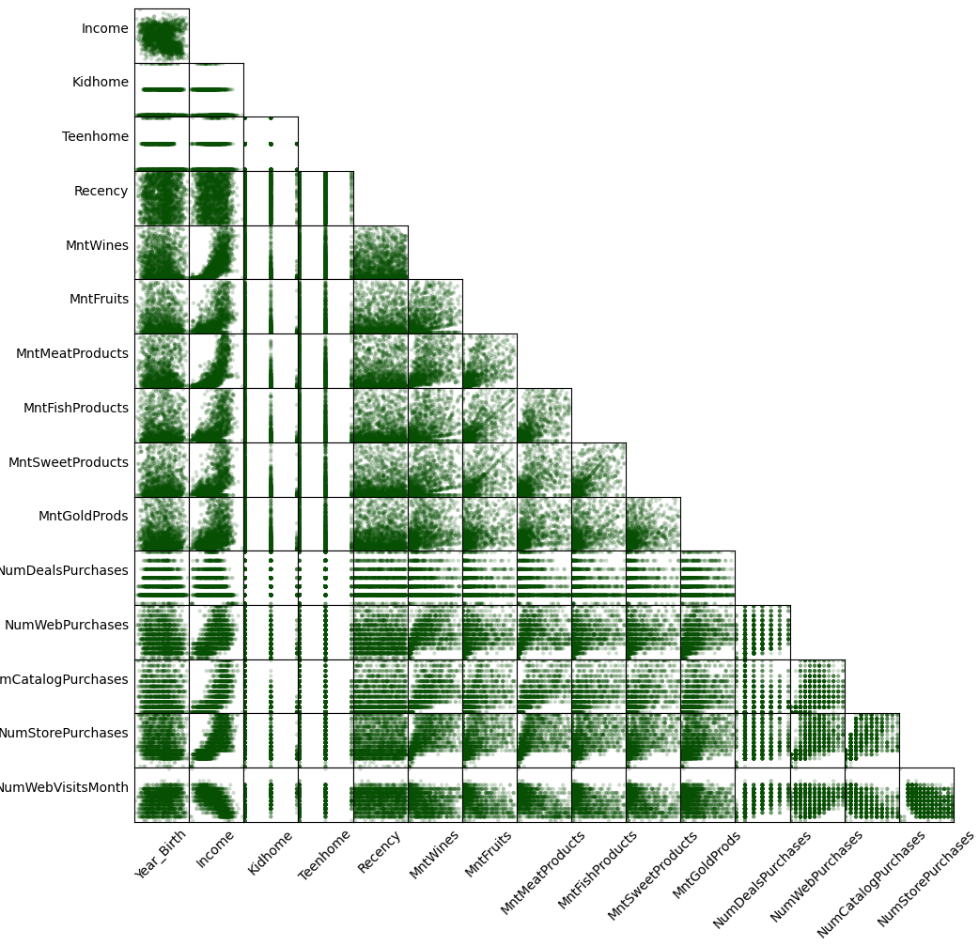
Income seems strongly correlated with most variables, while Year_Birth does not
Specifically, Income is negatively correlated with NumWebVisitsMonth
The correlation between Income and the Mnt… variables is mostly positive and non-linear

Slide 16
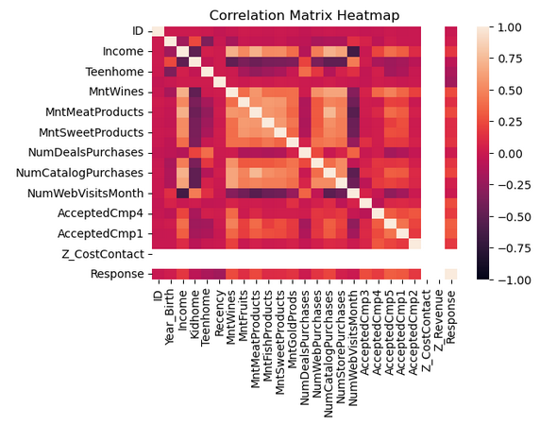
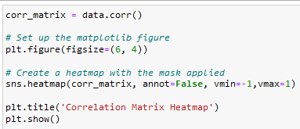
To confirm the co-relation. Let's plot corr_matrix
Heatmap

Slide 17
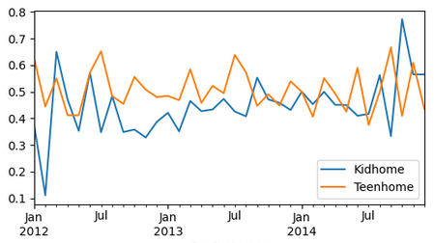
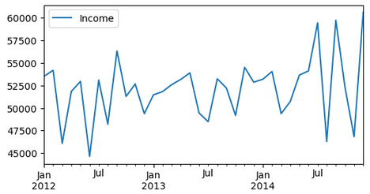
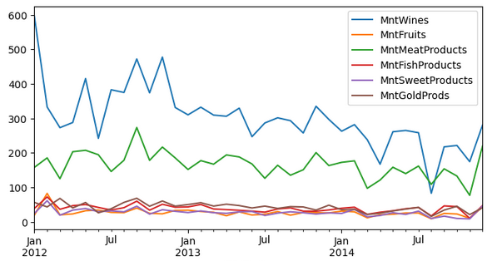
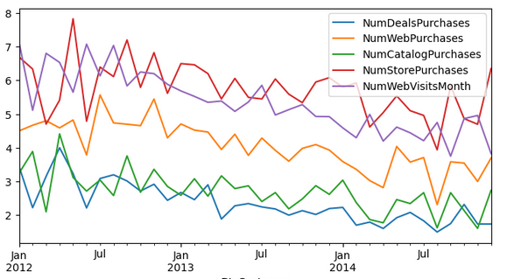
# Number of Kids and Teens over Time
# Income over Time
Kidhome and Teenhome seem stable throughout time.
These two variables seem to behave very similarly.
Average income seems to be getting higher with time, but that trend is not super clear.
# Amount Spent per Product over Time
# Type of Purchase over Time
Overall sales of most products seem to be decreasing over time. That trend can be confirmed by looking at the num of purchases:
Counts of type of purchases seem to be decreasing over time.

Slide 18
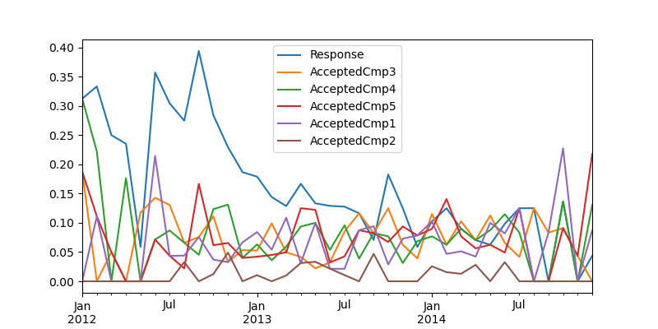
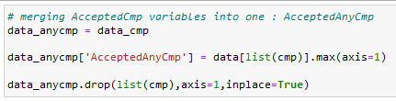
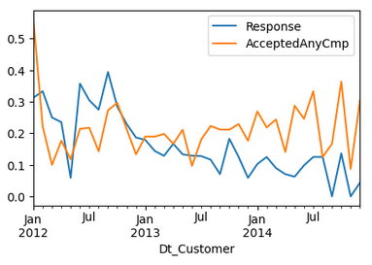
let us look at the variables related to campaign and response
It's hard to see much, So let's merge all the AcceptedCmp.. variables to see if its get's clearer
Response and AcceptedAnyCmp seem to follow opposite trends.

Slide 19
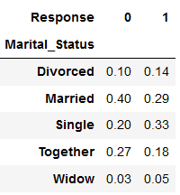
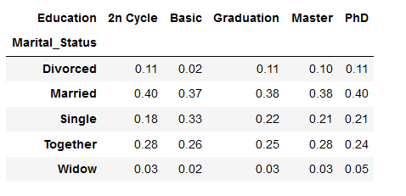
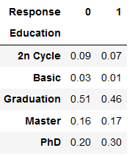
Finally, let us check the relationship between some categorical variables.
# Marital Status vs Response
We can see that people who are not in a relationship (single, widow or divorced) are more likely to accept our offer than those who are (together or married). This is particularly valuable if we want to target customers later.
# Marital Status vs Education
# Education vs Response
40% of people who have a PhD are also married.
Higher education levels (Master and PhD) make people more likely to accept an offer.
crosstabs

Slide 20
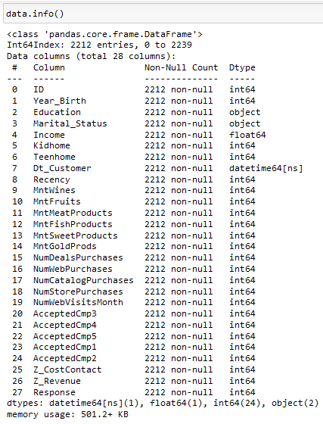
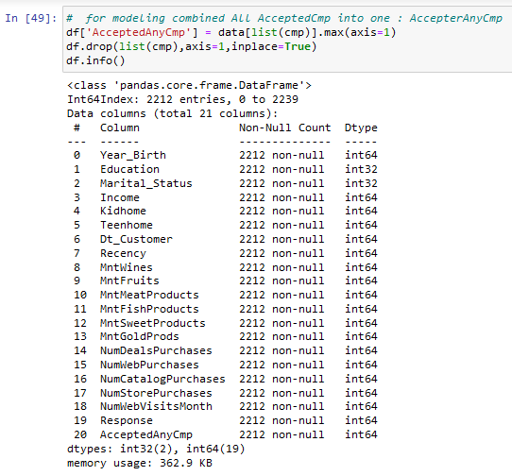
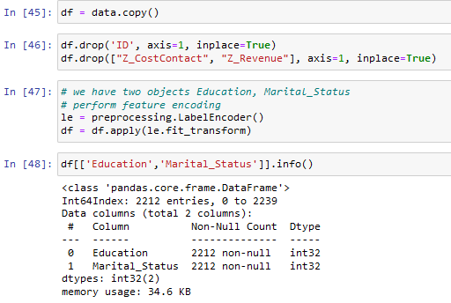
4. Data Preparation and Splitting

Slide 21
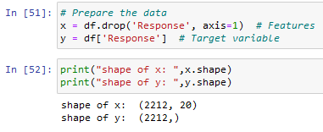
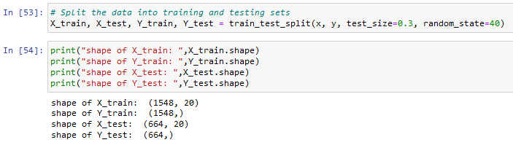
Data Splitting

Slide 22
5. Model Selection and Training
Logistic Regression: A classification algorithm used for predicting binary outcomes based on input features.
Decision Trees: A tree-like model used for classification and regression tasks, where each internal node represents a feature, each branch represents a decision, and each leaf node represents an outcome.
Random Forest: An ensemble learning method that combines multiple decision trees to improve predictive accuracy and reduce overfitting.
Gradient Boosting: An ensemble technique that builds multiple weak learners (typically decision trees) sequentially, with each one correcting the errors of its predecessor, leading to improved model performance.

Slide 23
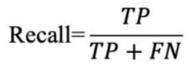
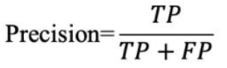
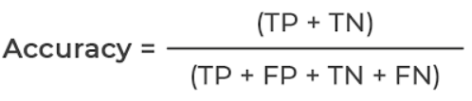
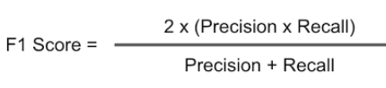
Evaluating Metrics
Predicted Values
0
1
0
TRUE NEGATIVE
FALSE POSITIVE
True Values
1
FALSE NEGATIVE
TRUE POSITIVE

Slide 24
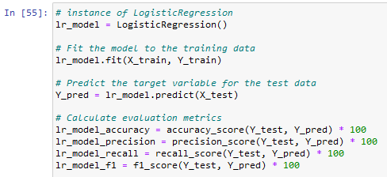
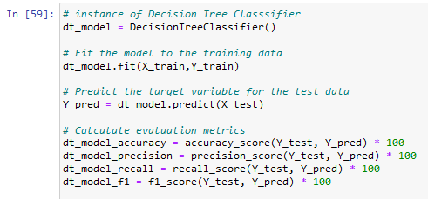
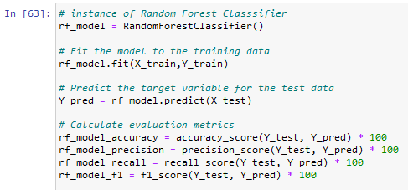
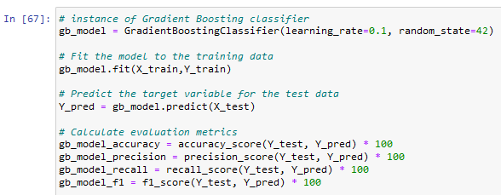
5.1 Logistic Regression
5.2 Decision Trees
5.3 Random Forest
5.4 Gradient Boosting

Slide 25
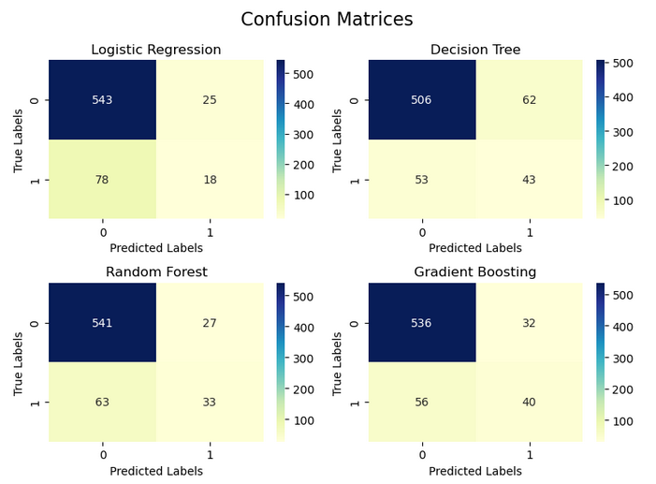
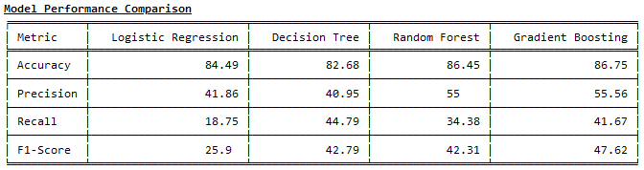
Evaluating Metrics of all the 4 models to compare :

Slide 26
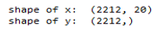
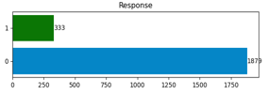

Resampling and splitting the data
1546
1879

Slide 27


Modelling on Resampled Data

Slide 28




Evaluating Metrics of all the 4 models Trained on Resampled data :

Slide 29



6. Evaluating Model Performance (on Resampled Data)
Predicted Values
0
1
0
TRUE NEGATIVE
FALSE POSITIVE
True Values
1
FALSE NEGATIVE
TRUE POSITIVE

Slide 30
7. Conclusion
Based on the results obtained from the resampled data, it is evident that the Random Forest and Decision Tree models have performed the best. Since our business problem focuses on "enabling targeted marketing strategies and optimizing campaign effectiveness," the key criteria for selecting the best model are accuracy and f1 scores.
Among the two models, the Random Forest model stands out with the highest accuracy of 95.47% and the best f1 score of 95.60%. These metrics indicate that the Random Forest model demonstrates excellent predictive capabilities and can effectively identify positive and negative responses from customers, making it a reliable and effective model for the task at hand.
Therefore, it is recommended to utilize the Random Forest model for predicting customer responses in your marketing campaigns. Its high accuracy and f1 scores make it a suitable choice for enabling targeted marketing strategies, ensuring that the campaigns are more efficient and successful in reaching the right audience and optimizing overall campaign effectiveness.

Slide 31

8. PowerBI Dashboard

Slide 32
Thank You

